Slide 1
SPARK DATA QUALITY FRAMEWORK By Sanjeeb Panda 07/12/2017
https://github.com/spanda2020/dataqualityv2

Slide 2
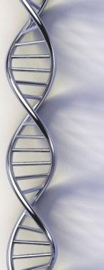
Agenda :
1
ENTERPRISE DATALAKE OVERVIEW
2
BUSINESS BENIFITS
3
DQ DATA MODEL
4
EXECUTION SNAPSHOTS
5
WHAT NEXT & QUESTIONS

Slide 3
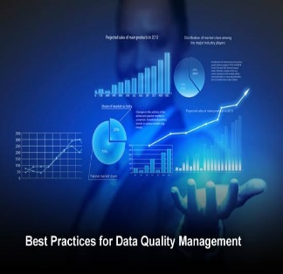
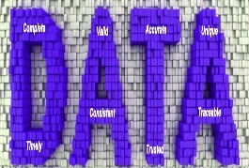


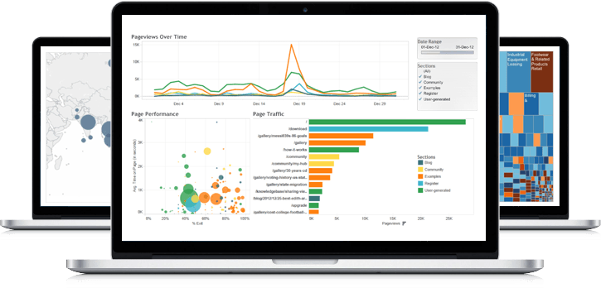



1
External Data (Data Sourcing)
Data Lake
Business Layer
Data Bases
Archive Layer (Hive/HDFS)
Data Transformations
Business Intelligence
SQOOP
View Layer
Data Transformation Layer
Visualization
File System
Reporting Layer
Advanced Analytics
Data Extracts Outbound feeds
Stage Layer (Hive/HDFS)
NDM/SFTP/FLUME/
KAFKA

Slide 4
2
Highlights & Business Benifits:
One stop Solution .
Can be integrated with any Hadoop Platform (Cloudera/Hortonworks).
Implemented with Spark Data Frame, PySpark.
Fully automated. Very Less manual effort during environment upgrade.
All the artifacts (Rules/DQ output/Log) will be loaded in database (Hive).
All execution will be attached to a unique partition.
Scheduling can be done through autosys or Oozie or any scheduling tool.
Easy reporting. Can be connected through Zeppelin or reporting tool.

Slide 5
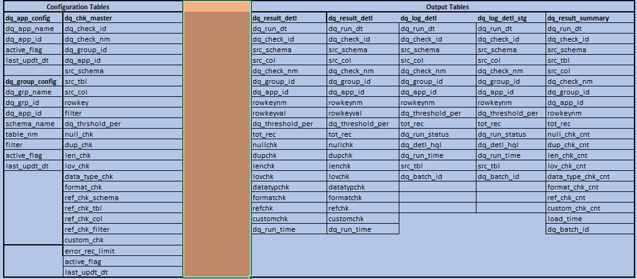
3
DATA QUALITY DATA MODEL:

Slide 6
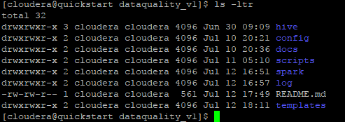
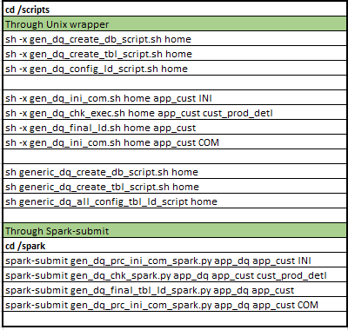
4
Folder Structure
Execution Steps

Slide 7


5
What next ???
Trend analysis of error % .
Report generation using either python modules or Zeppelin.
Restart Features Will be added/

